Slide 1


Slide 2

Online Movie
Ticket Booking
System

Slide 3

A Project Report On “Online movie ticket booking SYSTEM” In Java Submitted to, SHIVAJI UNIVERSITY, KOLHAPUR In the partial fulfillment of award of degree BACHELOR OF SCIENCE-Information Technology (Entire) (B.Sc. I.T Part -III) Submitted by, Mr. Jilani Javed Pathan. Mr. Saalemahamad Sadik Momin. Under the guidance of, Prof. P. A. Kupade Through,
The Principal,
Karmaveer Bhaurao Patil College, Urun-Islampur,
Tal - Walwa, Dist- Sangli

Slide 4
Introduction
The Online Movie Ticket Booking project in Java is a software application that provides a convenient way for users to book movie tickets online. This project aims to streamline the ticket booking process, making it easier and more efficient for both users and theatre owners. The project allows users to browse through a list of available movies, view their details such as title, genre, cast, and show timings. Users can select their preferred movie and choose a showtime that suits them. The application provides real-time information on seat availability and lets users select their desired seats from a seating layout. The project includes an admin panel that allows owners or administrators to manage movie listings, update show timings, monitor bookings, and view sales reports. The Online Movie Ticket Booking project in Java provides a user-friendly and efficient platform for booking movie tickets online. It simplifies the ticket booking process, reduces waiting time, and enhances the overall movie-going experience for users. Whether it's selecting seats, making payments, or managing bookings, this project offers a comprehensive solution for both users and theatre owners.

Slide 5
Existing System
The existing system for the Online Movie Ticket Booking project primarily involves manual ticket booking processes, both online and offline. It typically consists of physical ticket counters at movie theaters where customers have to visit in person to purchase tickets. Alternatively, some theatre may offer phone- based bookings or bookings through third-party websites. Customers have to physically visit the theatre to purchase movie tickets. They stand in queues, sometimes for extended periods, to buy tickets for their desired showtimes. This process is time-consuming and inconvenient, especially during peak hours or for popular movie releases

Slide 6
Objective of System
The objectives of this study is as follows: ➢ To evaluate the way of interaction with customers. ➢ To develop a movie ticket booking system with web application based on the client server application. ➢ To determine the factors that influence customer when booking a ticket online. ➢ To computerized the movie ticket booking system process and display details of sales history.

Slide 7
System Specification
Hardware And Software Hardware Requirements The system requirements divided into two categories Hardware and Software requirement are as follows: Hardware Requirements: 1. Processor : Intel(R) p4,2.66 Ghz Ht. 2MB Cache 2. RAM : 1 GB 3. Hard disk : 40 GB Har disk (7200 RPM) 4. Input Device : Keyboard, Mouse. 5. Output Device : Monitor, Printer. Software Requirements: 1. Operating System: Windows –10 2. IDE: Netbeans 7.2 3. Front-End Tool: Java Script, Html, Css 4. Back-End Tool: MYSQL, Java 5. Reports: Jasper Report

Slide 8
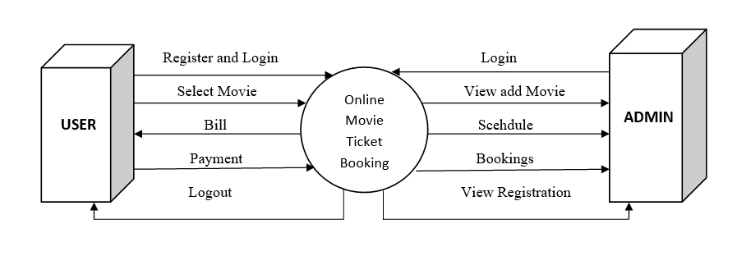
Data Flow Diagram

Slide 9
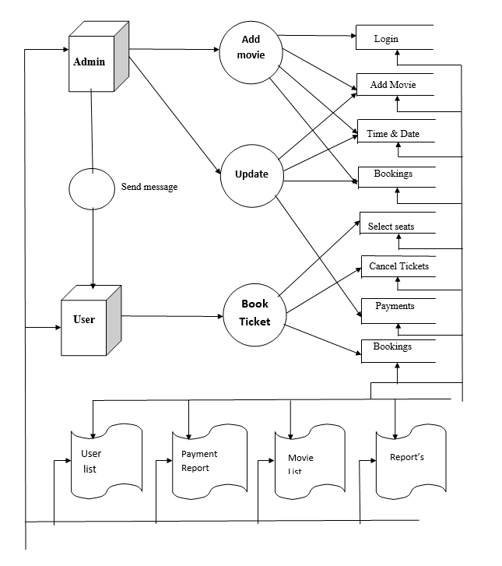
Data Flow Diagram

Slide 10
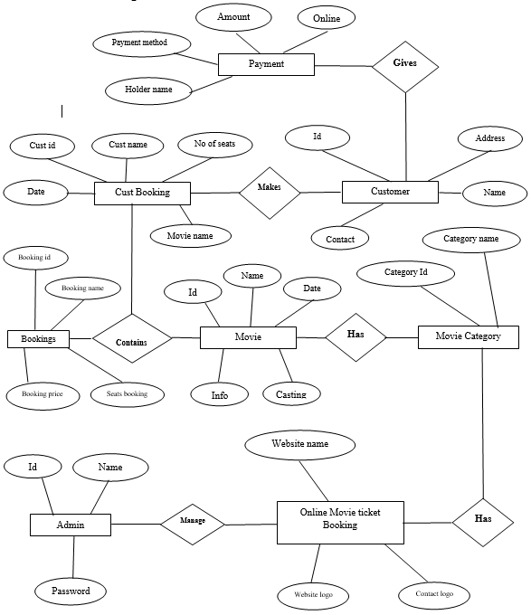
ER Diagram

Slide 11
Input
&
Output
Screens

Slide 12
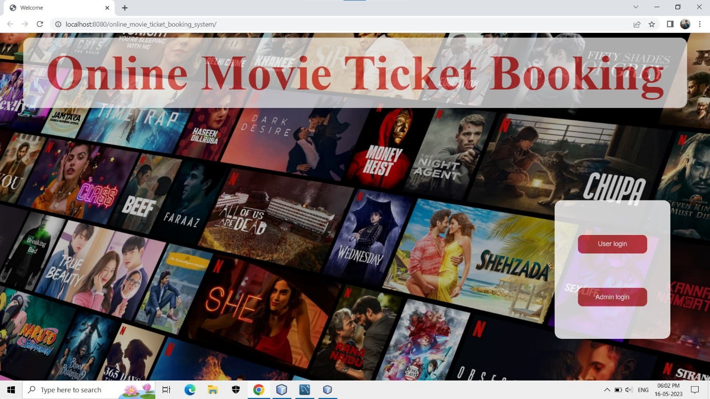
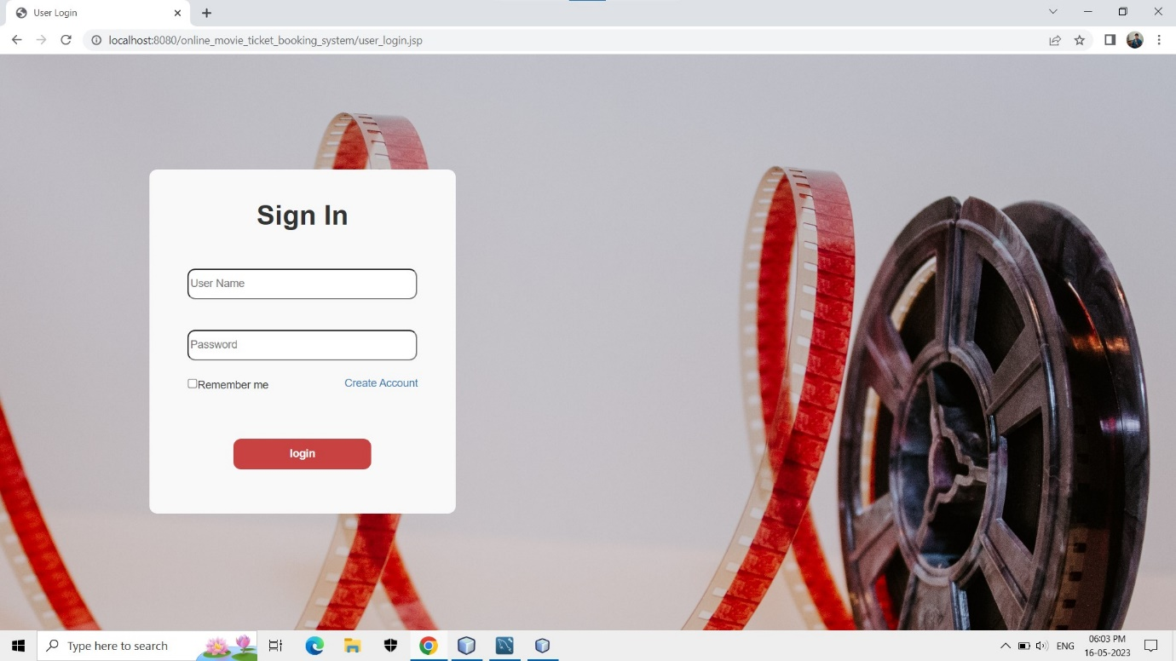
Home Page of Website
User Login

Slide 13
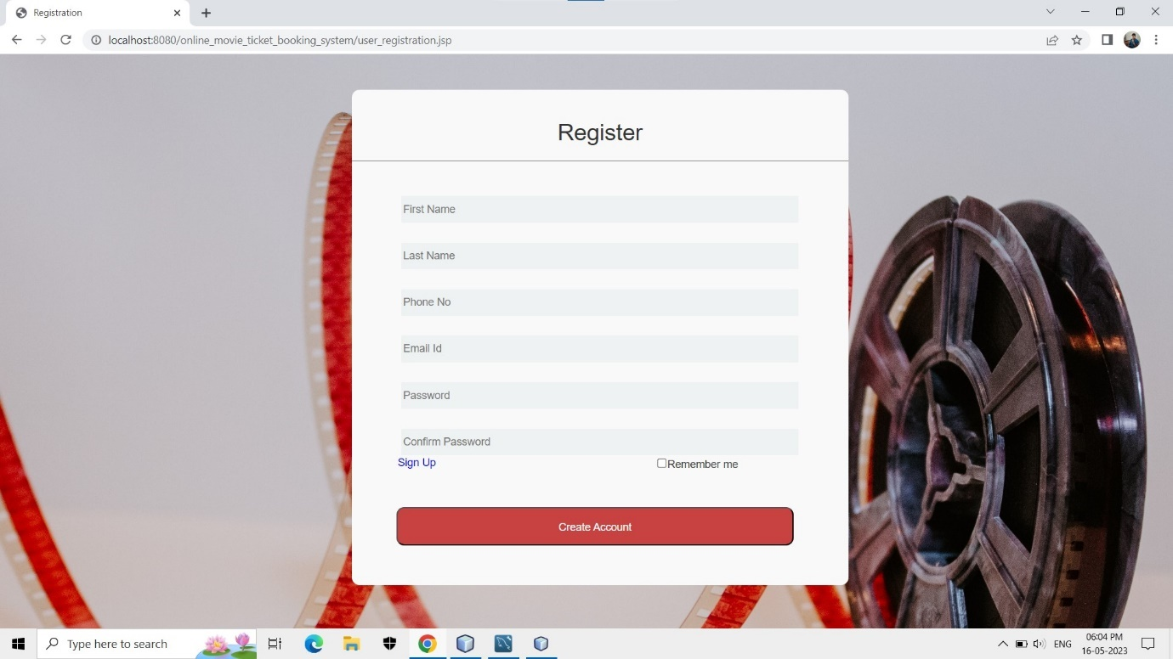
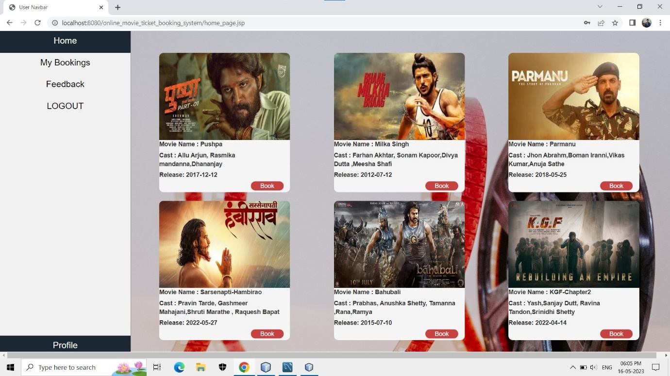
User Registration
Home page

Slide 14
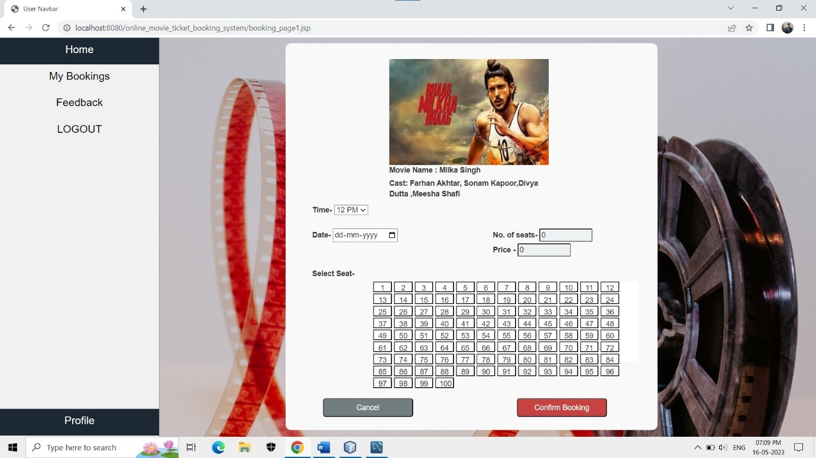
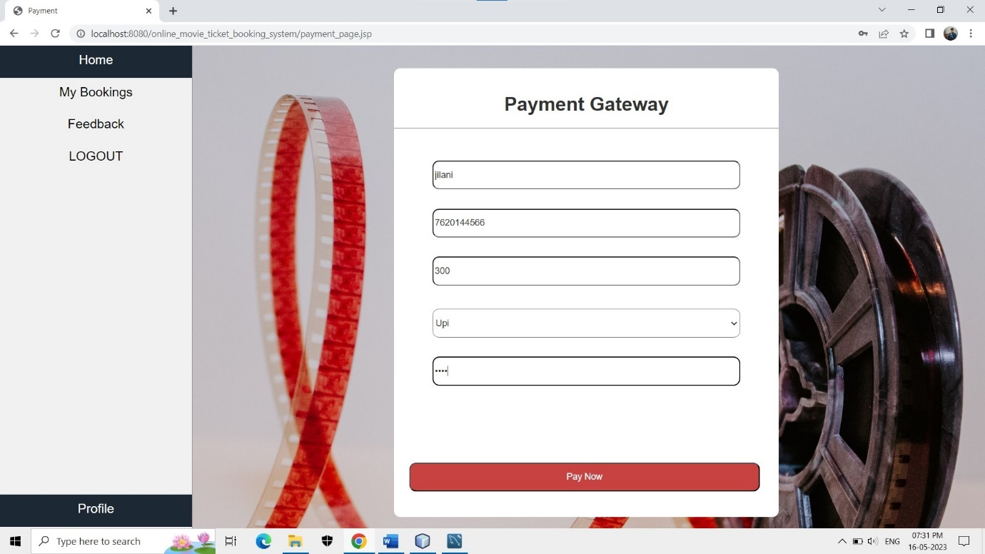
Booking Page
Payment Page

Slide 15
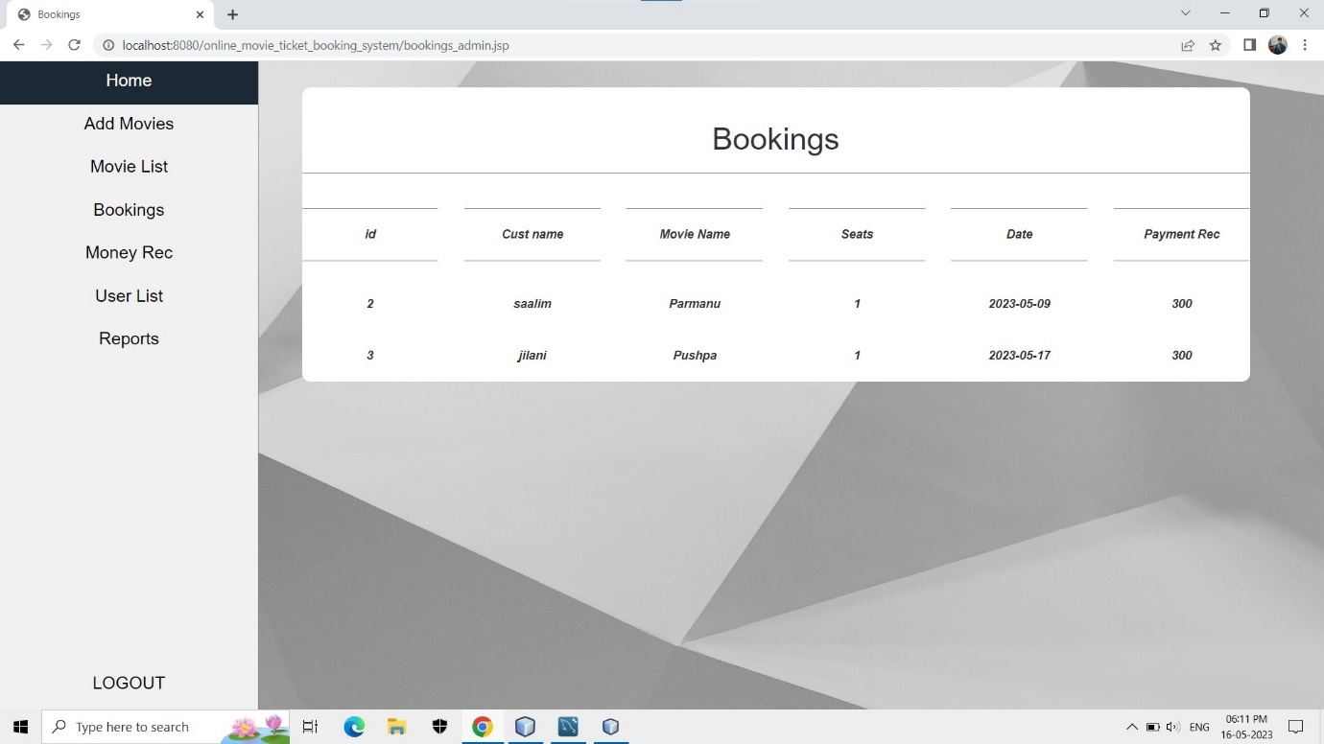
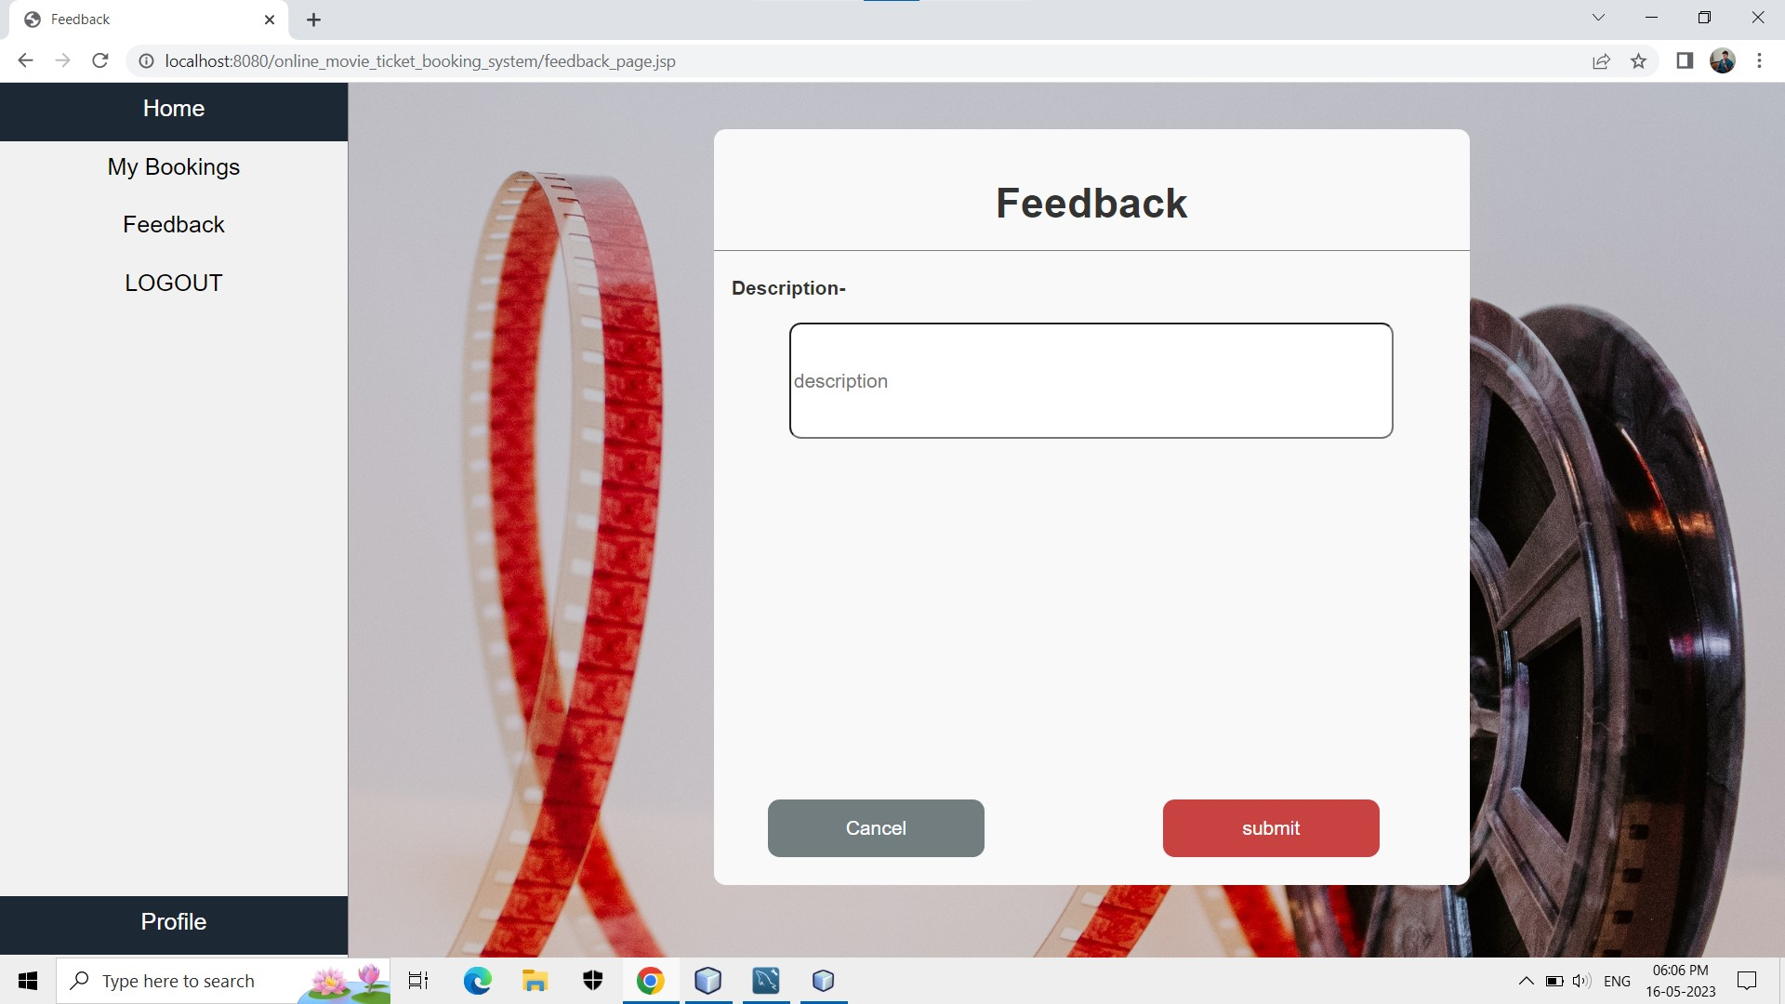
My Bookings
Feedback Page

Slide 16
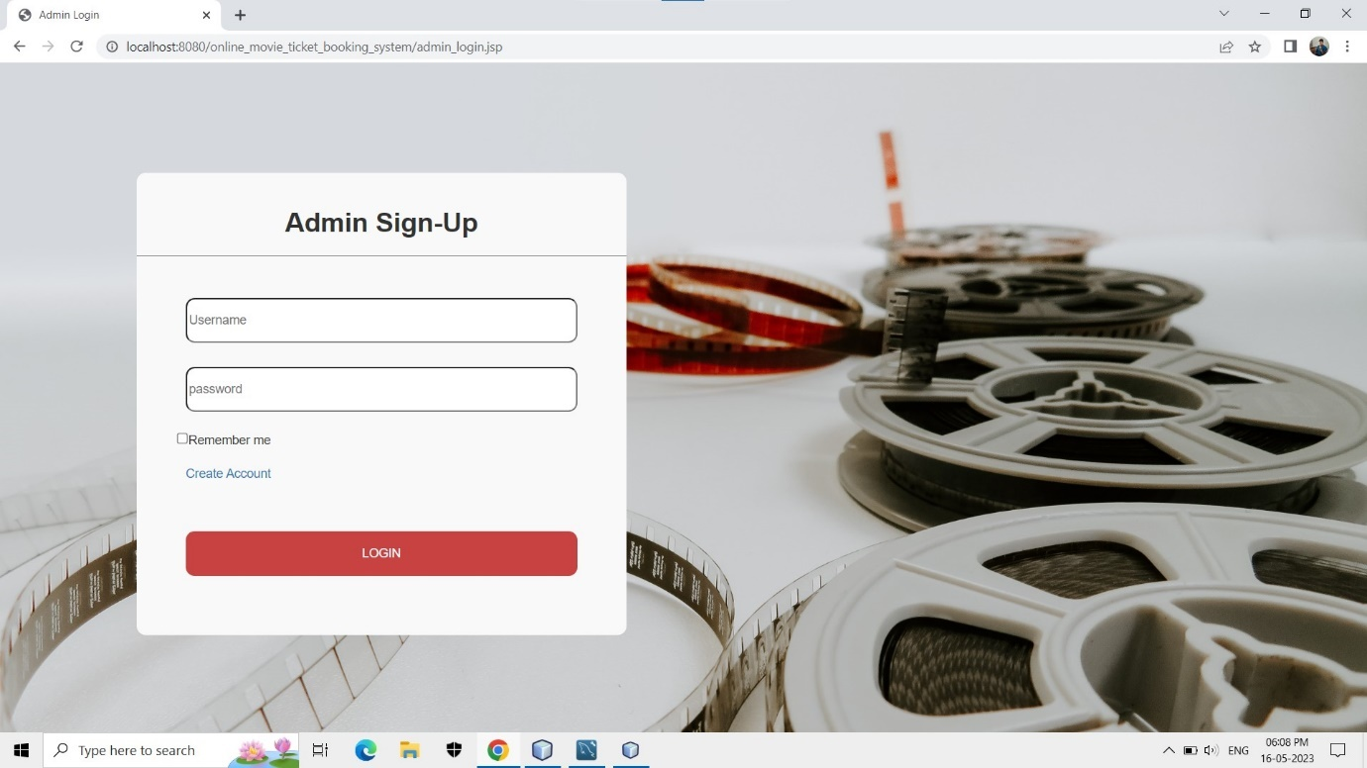
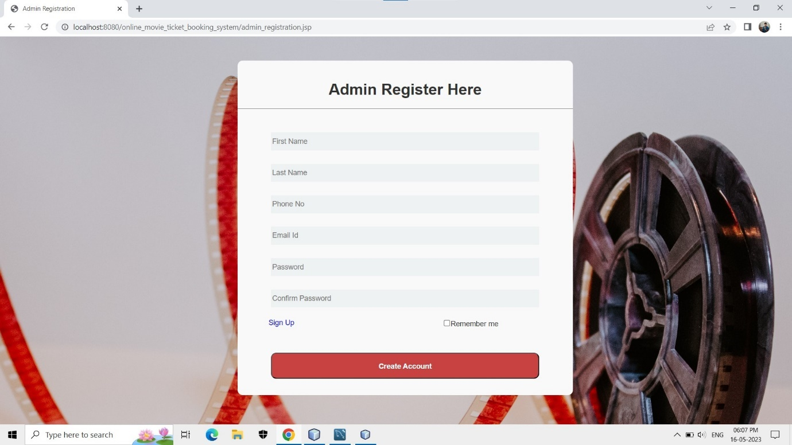
Admin Login
Admin Registration

Slide 17
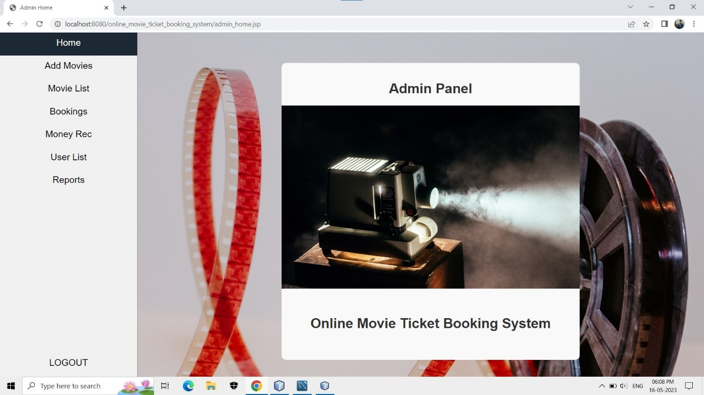
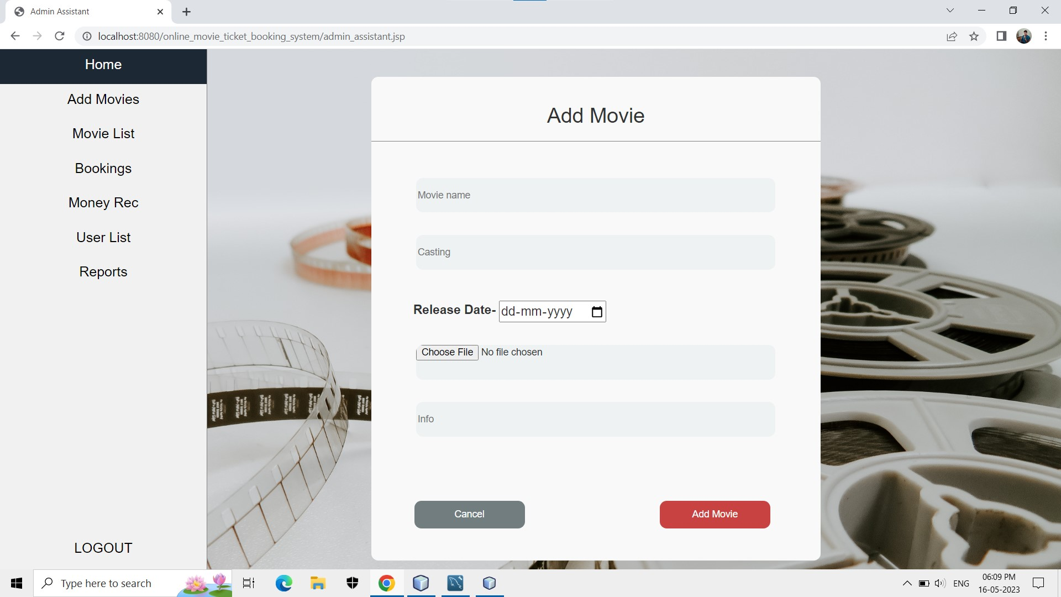
Admin Home
Admin Assistant

Slide 18
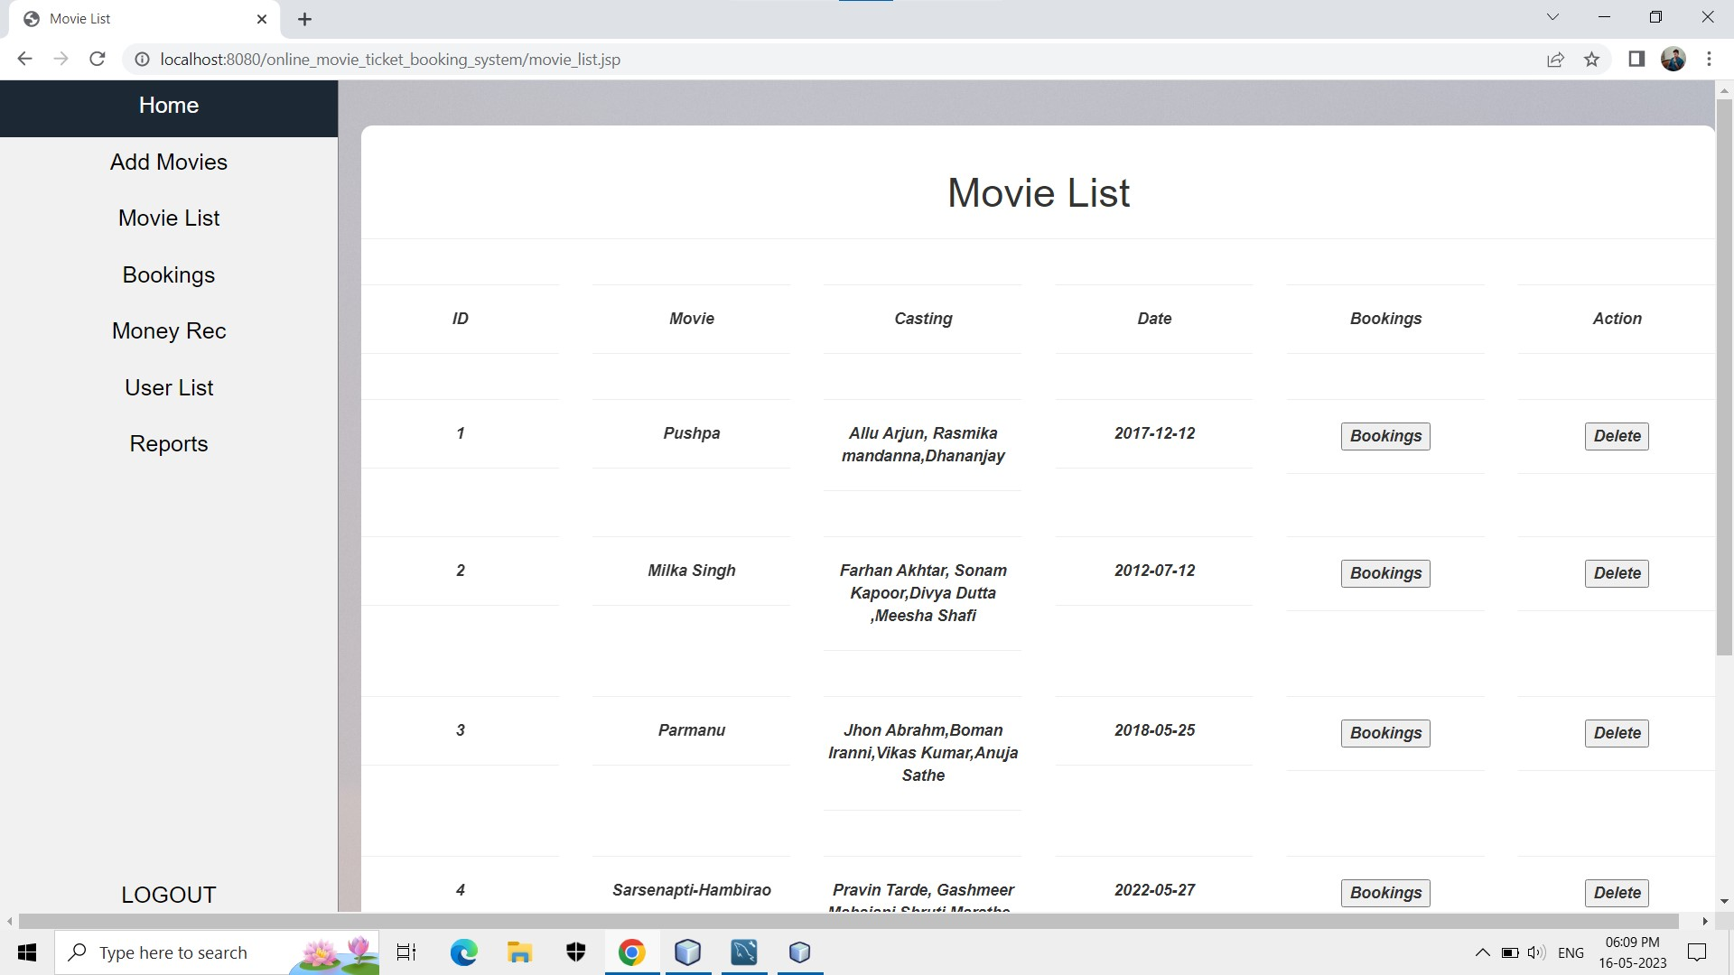
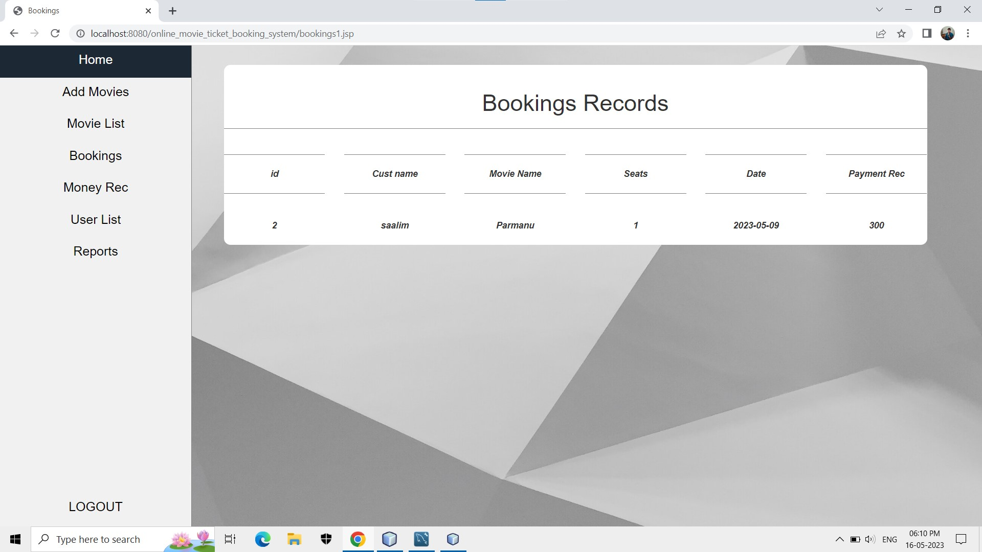
Movie list
Booking records

Slide 19
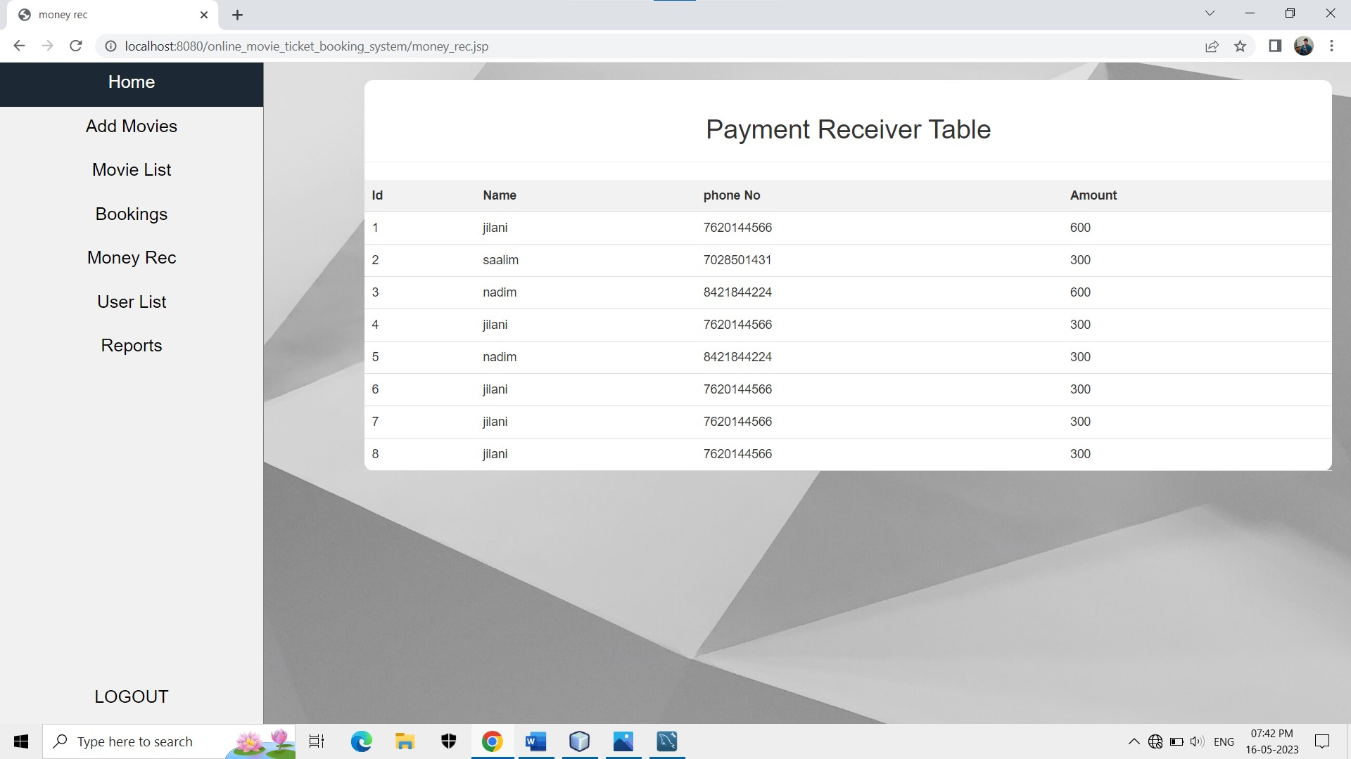
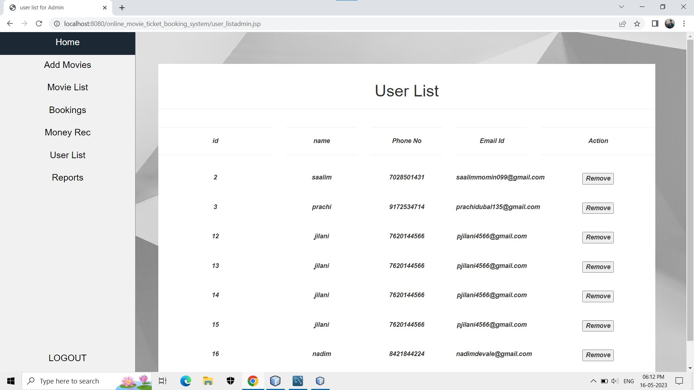
Money rec
User List

Slide 20
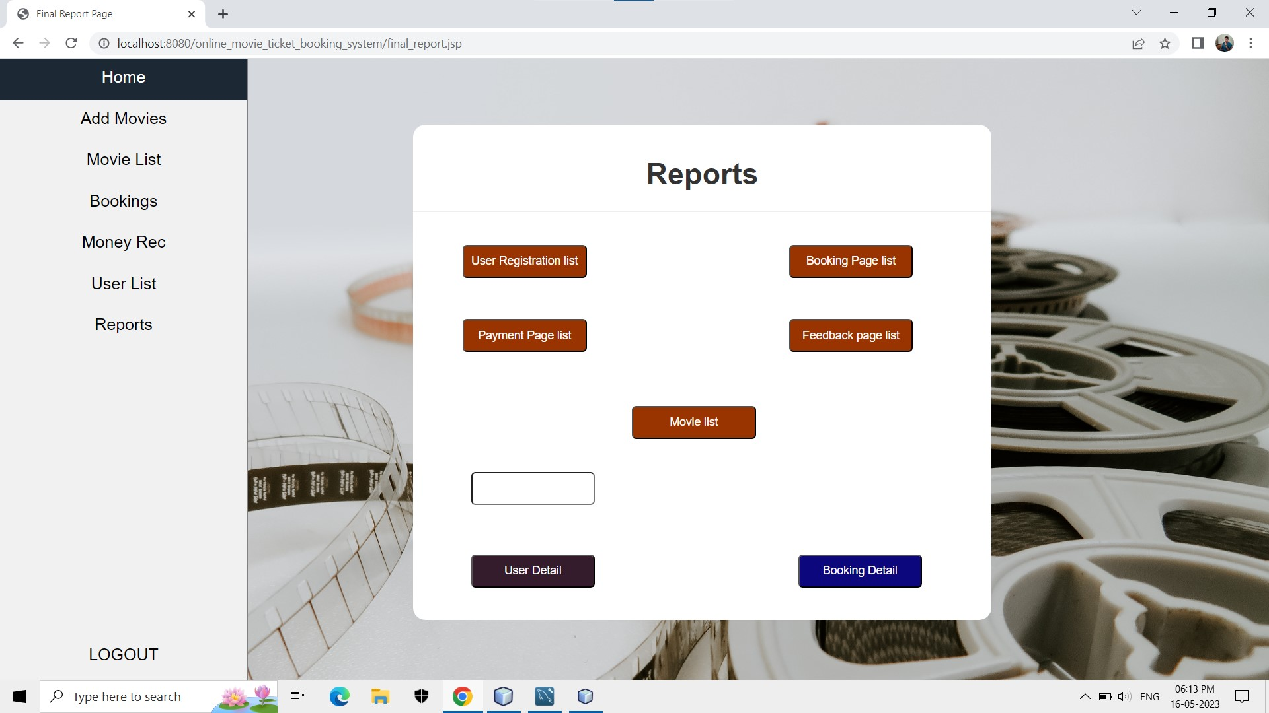
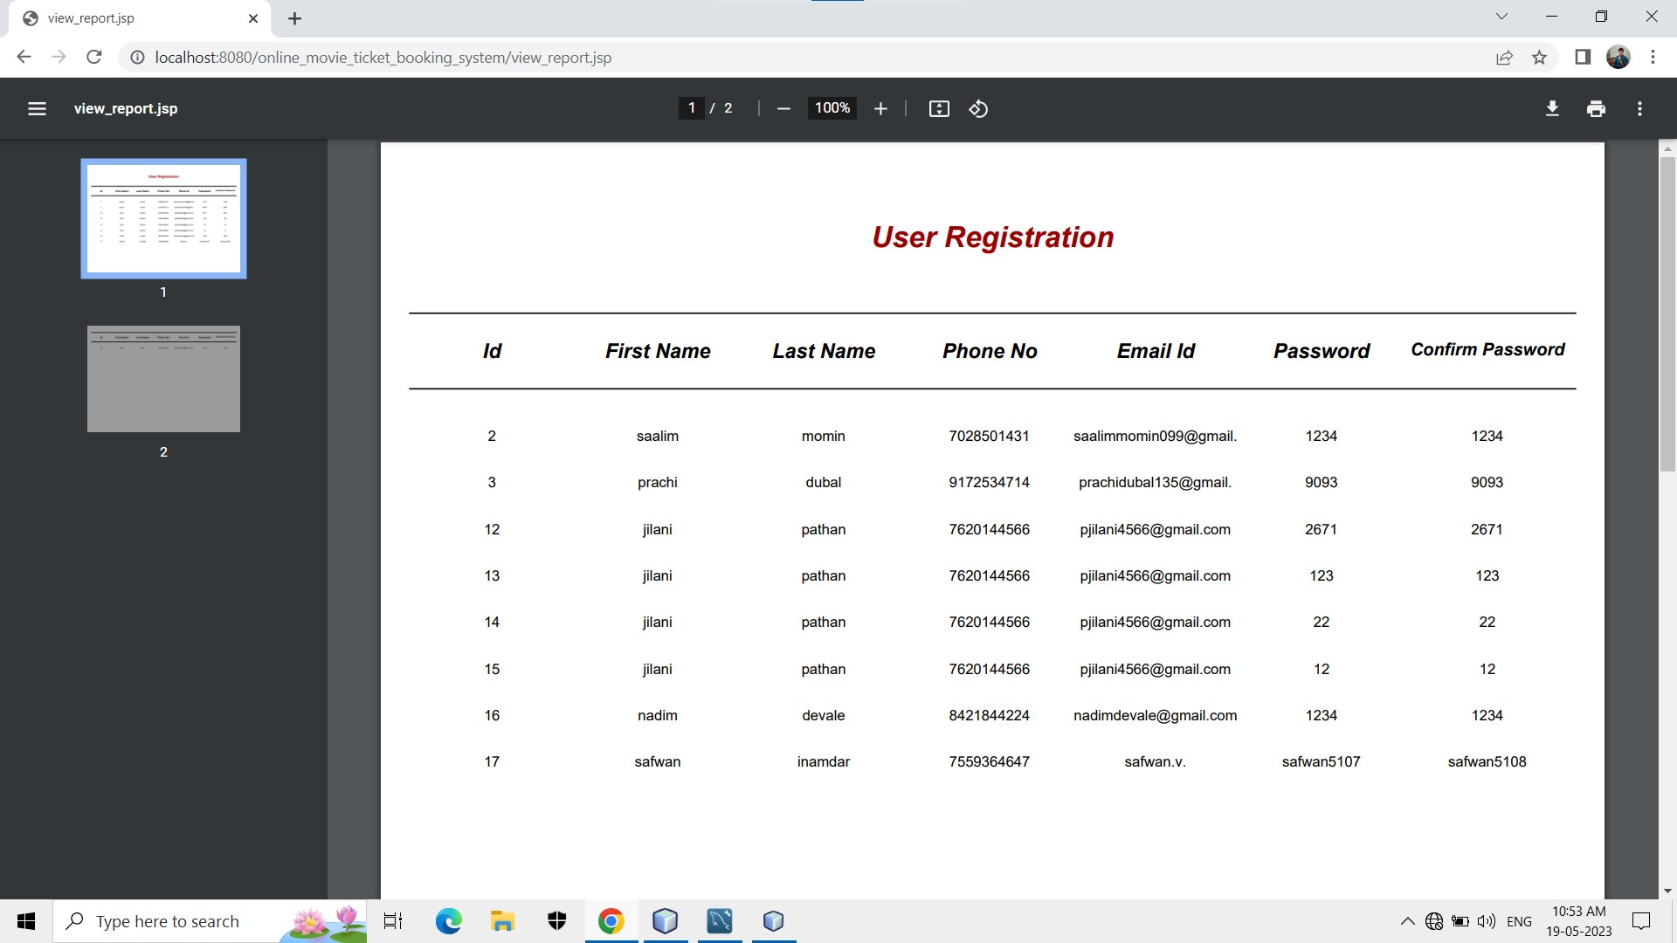
Report’s
User registration

Slide 21
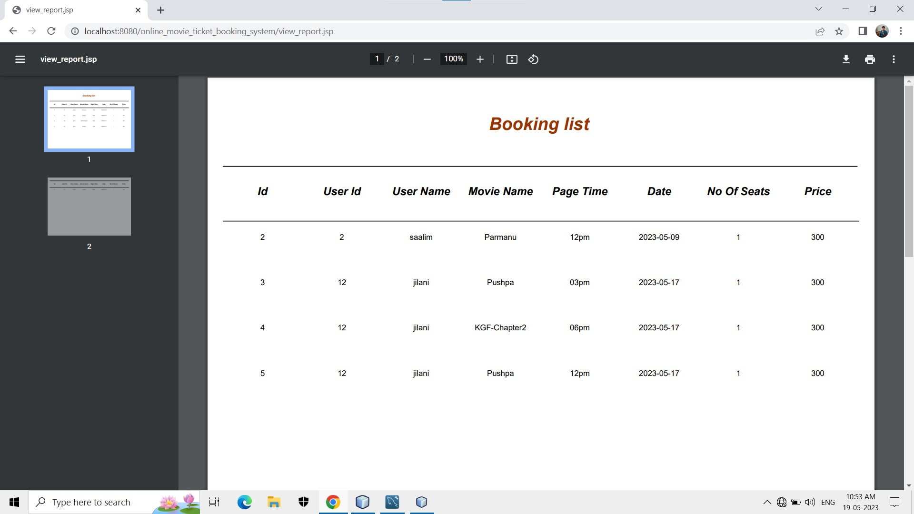
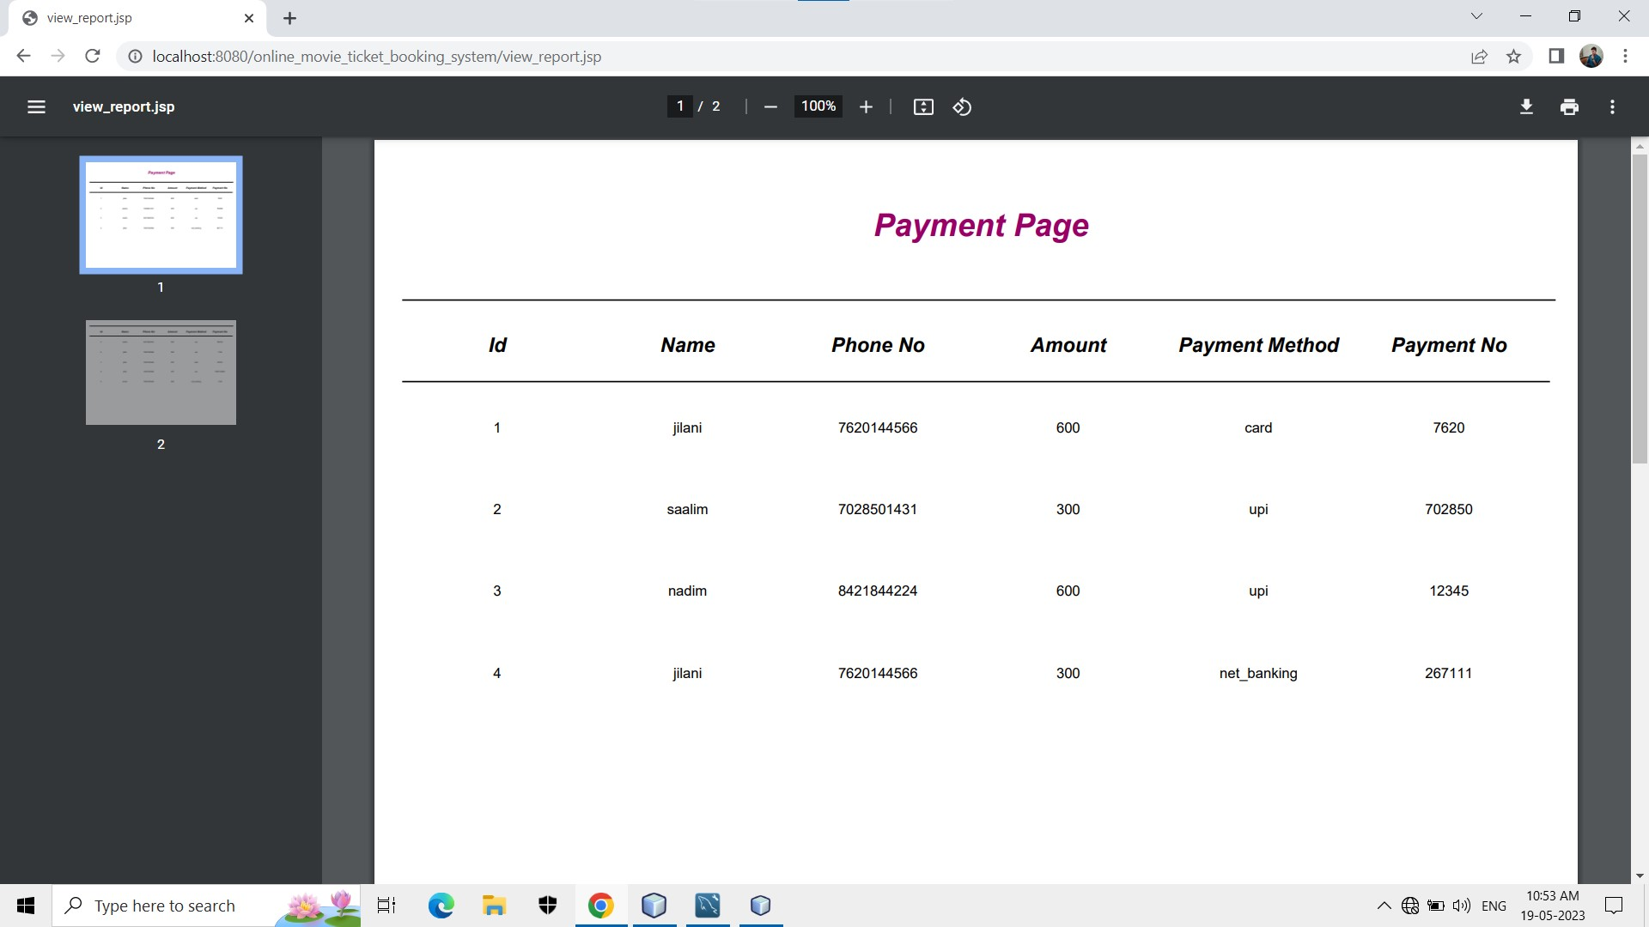
Booking List
Payment Page

Slide 22
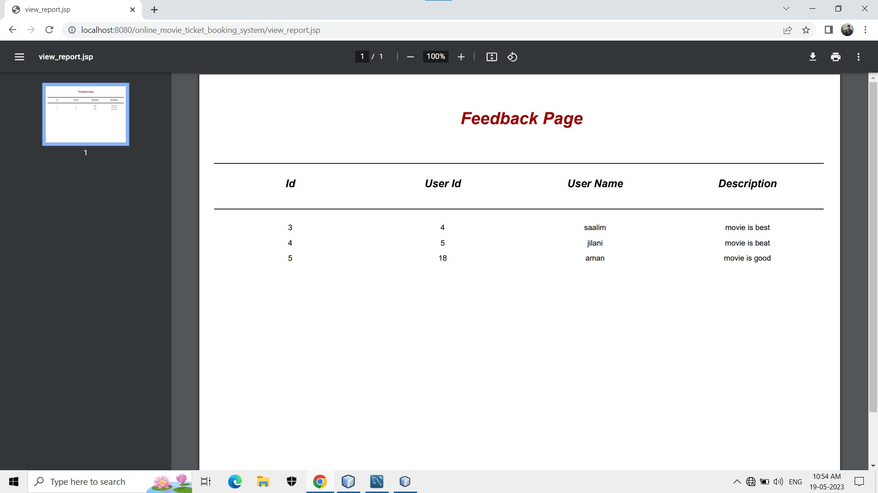
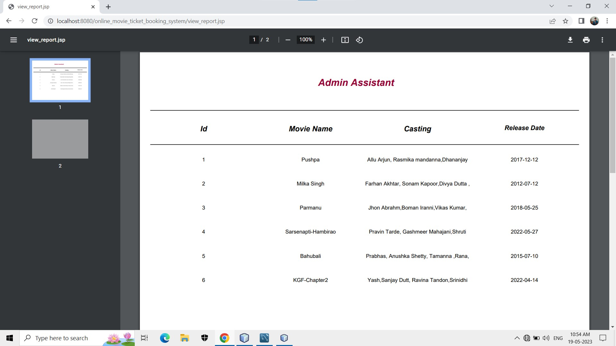
Feedback Page
Movie List

Slide 23
Limitations
Every system has some limitations and because of limitation there is a occurrence of suggestion here we discuss the limitation suggestion of our system “Online Movie Ticket Booking System”.
Limitations: -
This System runs only windows platform
This System is not Single user
Deleted record cannot be recovered
Suggestions: -
The user should enter data correctly
While getting reports check whether printer is ready or not
To start this system, you have to enter correct password
Follow the user manual whenever necessary
The user knows detail information about the system

Slide 24
Conclusion:
Our project is only a humble venture to satisfy the needs to manage their project work. Several user-friendly coding have also adopted.
A description of the background and context of the project and its relation to work already done in the area.
Made statement of the aims and objectives of the project.
The description of Purpose. Scope, and applicability
We define the problem on which we are working in the project.
We describe the requirement Specifications of the system and the actions that can be done on these things.
We understand the problem domain and produce a model of the system, which describes operations that can be performed on the system.
We included features and operations in detail, including screen layouts
We designed user interface and security issues related to system. Finally, the system is implemented and tested according to test cases

Slide 25


